Slide 1


MULTI-CLOUD AND HYBRID CLOUD STRATEGIES FOR ENTERPRISE IT
CSA-1514 Cloud Computing and Big Data Analytics
Technical Presentation
Presented By: Daniel Sam K (192524081)
Guided By : Dr.Latha

Slide 2
MULTI-CLOUD VS HYBRID CLOUD
Point | Multi-Cloud | Hybrid Cloud
1. Meaning | Uses two or more cloud providers. | Combines private and public cloud.
2. Example | AWS + Azure + Google Cloud | Company Data Center + AWS
3. Main Purpose | Flexibility and avoiding dependence on one provider. | Combining data control with cloud scalability.
4. Data & Workloads | Workloads can be distributed across different cloud providers. | Sensitive workloads can stay private while other workloads use public cloud.
5. Main Benefit | More choice and flexibility. | Better control, security and scalability.
Simple idea:
Multi-Cloud = Multiple Providers
Hybrid = Private + Public

Slide 3
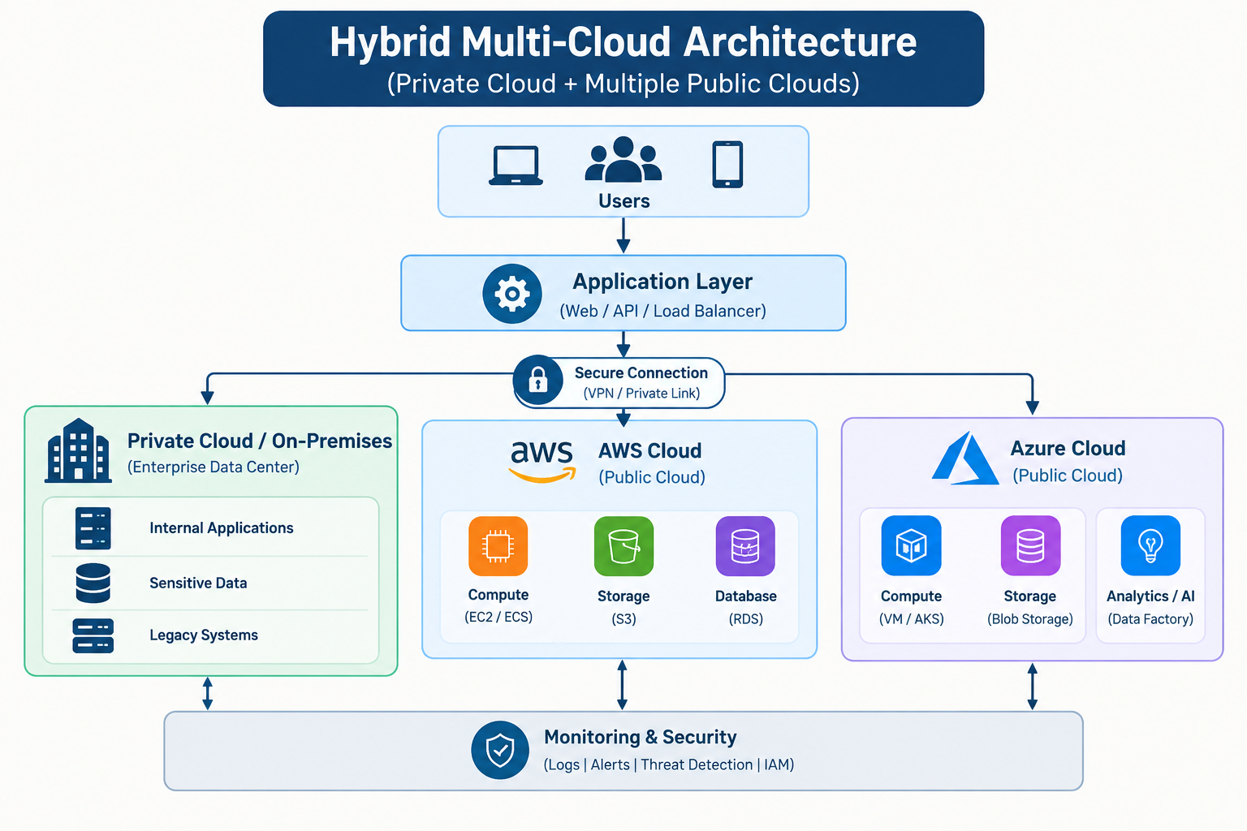
HOW THE ARCHITECTURE WORKS

Slide 4
BUSINESS BENEFITS
Flexibility – choose the best cloud for each workload.
Scalability – increase or decrease resources when required.
High Availability – reduce dependence on one environment.
Cost Optimization – select suitable services and pricing.
Vendor Lock-in Reduction – avoid complete dependence on one provider.
Data Control – keep sensitive workloads in private infrastructure.
Disaster Recovery – maintain backup and recovery options.

Slide 5
CHALLENGES
Complex architecture and integration.
Different tools and technologies across cloud providers.
Data synchronization and network management.
Security and identity management across environments.
Monitoring and controlling costs can be difficult.
Requires skilled technical teams.

Slide 6
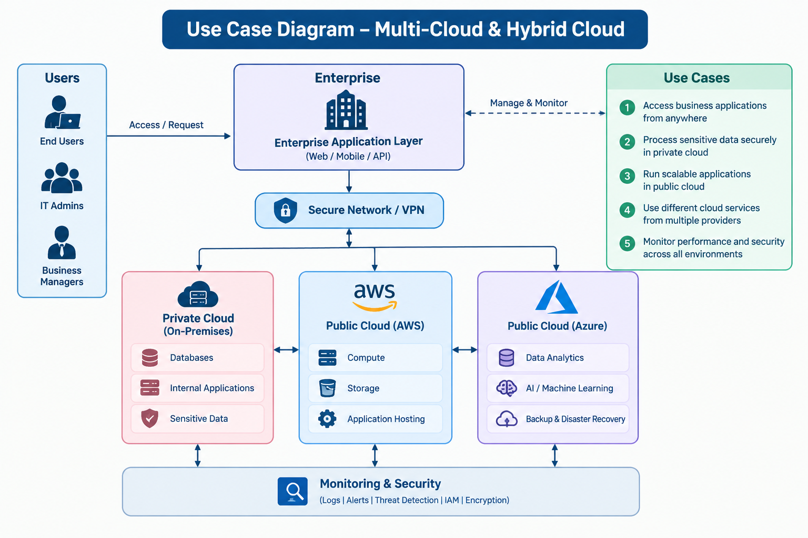
REAL-WORLD USE CASE: E-COMMERCE

Slide 7
CONCLUSION & KEY TAKEAWAY
Multi-Cloud uses multiple cloud providers.
Hybrid Cloud combines private and public infrastructure.
Both improve flexibility, scalability and workload management.
Security, cost and complexity must be carefully managed.
KEY TAKEAWAY
“Use the right cloud environment for the right workload.”

Slide 8
SECURITY IN MULTI-CLOUD & HYBRID CLOUD
Identity and Access Management (IAM) controls who can access resources.
Encryption protects data while stored and while being transferred.
VPN / private connections secure communication between environments.
Centralized monitoring helps detect unusual activity.
Security policies should be consistent across all cloud environments.
Key idea: More cloud environments require stronger and centralized security management.

Slide 9
CHOOSING THE RIGHT CLOUD FOR A WORKLOAD
A workload is an application, service or process that needs computing resources.
Sensitive Data → Private Cloud
Highly Scalable Web Application → Public Cloud
AI / Data Analytics → Cloud with suitable AI and data services
Backup / Disaster Recovery → Separate cloud or environment
Decision factors: Security • Cost • Performance • Scalability • Compliance

Slide 10
THANK YOU

